Slide 1

Level 4 Project Presentation
Gemma McDonald
Notes:
Hi, Im gemma, this is my fourth year project presentation on a mobile app to capture graduate attribute reflections.
(7 seconds)

Slide 2
Project Aims
Create an app to capture reflections on graduate attributes
Allow users to create a note with written or audio formatting
Remind users when they should reflect
Create a usable app
Aid reflection
Notes:
Graduate attributes, also referred to as ’soft’ skills,
encompass the abilities developed by students during university studies, that are not directly related to their chosen degree.
Industries have been found to be less concerned about the technical skills of graduates, and more with their soft skills,
but despite the expectation on universities to provide students with these skills, graduates are being found underprepared.
Creating an app that encourages users to reflect, using Cognitive behavioural therapy on their real-world experiences,
could increase awareness of these skills, encouraging their development and likelihood of success within the workplace.
Considering these motivations, the mobile app GradReflect was created with the following aims:
Create an app to capture reflections on graduate attributes
Allow users to create a note via written or audio form: allowing quick and convenient reflection.
Remind users when they should reflect: as finding the time to do this can be difficult.
Create a usable app: to encourage repeated use.
Aid reflection: to make it easy for users and encourage their continued reflection.
Now (0:57)

Slide 3
Graduate Attributes
Ethics and professionalism
Communication
Teamwork
Self-efficacy and Applying Knowledge
Adaptability
Critical Thinking
Reflection
K. Abernethy and K. Treu. Teaching computing soft skills: an experiential approach, 2009,
R. McDermott, G. Brindley, and G. Eccleston. Developing tools to encourage reflection in first year students blogs, 2010
Notes:
Each student will have a unique experience with graduate skills, with different areas of strengths and necessary development. These skills include but are not limited to:
Ethics and professionalism
Communication
Teamwork
Self-efficacy and Applying Knowledge
Adaptability
Critical Thinking and
Reflection: which is used to develop other soft skills, but is itself a graduate attribute.
Real-world experiences are vital in developing these skills, and in a course where students worked in teams to create software solutions for real clients, students developed both their communication and interpersonal skills. Reflection on these experiences have also been found to develop students critical thinking and self-sufficiency.
Was (1:50)
Now 1:15
: which will help graduates act responsibly, manage their time, and maintain an optimistic and willing attitude.
: which applies to both written and oral communication. Graduates must be able to interrogate ideas and present them clearly and concisely.
: will allow graduates to integrate seamlessly into the workplace and collaborate with colleagues.
: will help to take the technical knowledge gained throughout university and apply it within the workplace.
: Graduates will be expected to adapt to changing circumstances and quickly learn new skills, requiring the flexibility to respond effectively, even when things do not go to plan.
: and Problem solving skills are also required, as well as

Slide 4
Reflection
Stages of Reflection
1. Situation
2. Emotional state
3. Analysis of the cause and effects
4. Alternative thoughts
R. McDermott, G. Brindley, and G. Eccleston. Developing tools to encourage reflection in first year students blogs, 2010,
V. Thurner, S. Hammer, S. Ottinger, and M. Waldleitner. Development and Evaluation of an Assessment Tool for Self-Reflection, Apr. 2020
A. Bruno and G. Dell’Aversana. Reflective practicum in higher education: the influence of the learning environment on the quality of learning, Apr. 2018
Notes:
Reflection is a helpful tool in transforming experience into learning by analysing both the thoughts and emotions that occurred.
Reflection also helps relate these skills to previous experiences, making new connections and enabling these skills to be carried into the future.
The progressive stages of reflection assimilated from the literature are:
1. Situation describing the concrete experience.
2. Emotional state: describing the emotions felt during the event to gain insight and self-awareness.
3. Analysis of the cause and effects on both on their own and other’s emotions and behaviour.
4. Alternative thoughts: to examine the alternative ways the situation could have been handled and whether the best outcome was achieved, enabling improvements to be made in future similar scenarios.
However, students find it difficult to maintain reflection and are not provided the necessary supped to assist them in this practice. This identified a need for a framework to aid reflection within the app.
(0:50)

Slide 5
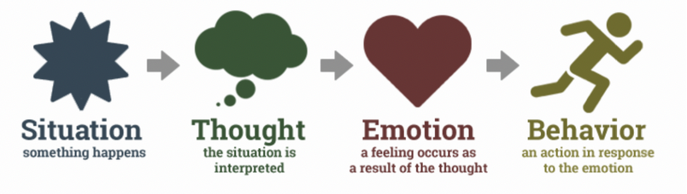
Cognitive Behavioural Therapy (CBT)
https://www.therapistaid.com/ therapy-guide/cbt-psychoeducation
Notes:
Through the research conducted into learning and developing students' graduate attributes through reflection, similarities with the practices of Cognitive Behavioural Therapy (CBT) were noted.
CBT is a form of psychotherapy based on the idea that a person’s thoughts will affect their emotions and behaviour. The therapist will work with the patient to alter these thoughts and behaviours to results in more positive outcomes.
To effectively use CBT techniques patients require a good understanding of this cognitive model, shown in this image.
This framework could be used to encourage deeper reflections from students about their soft skills.
(32 secs)

Slide 6
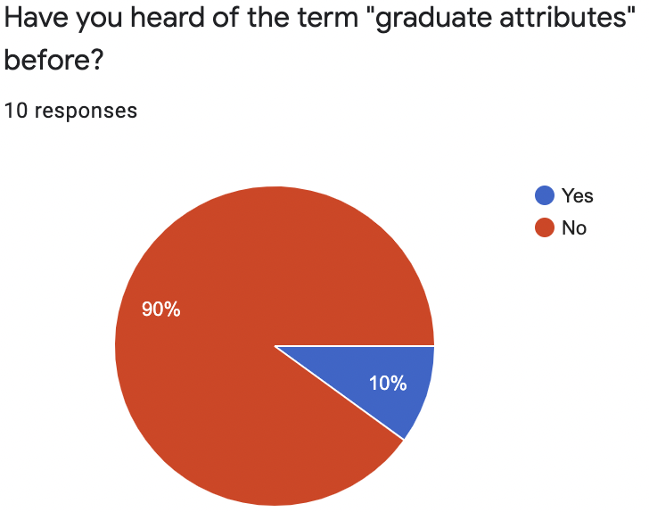
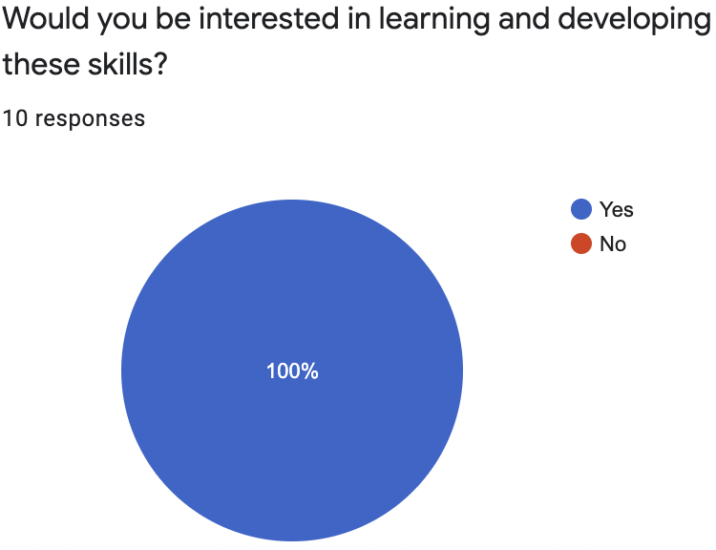
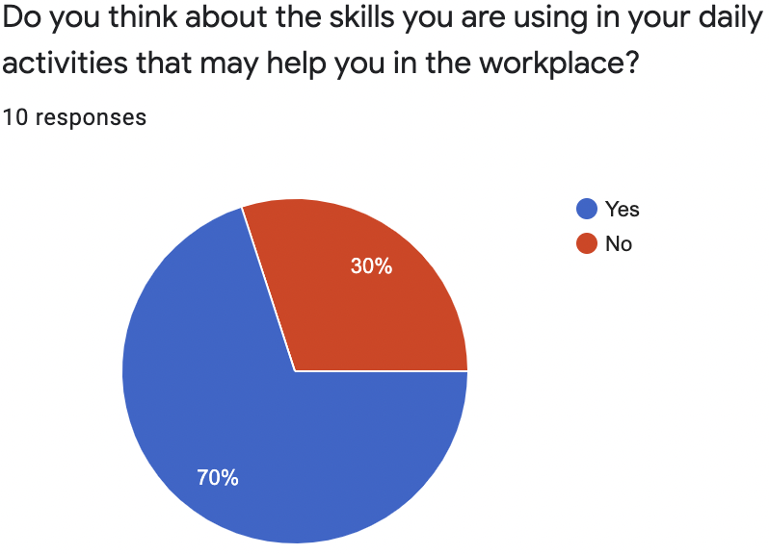
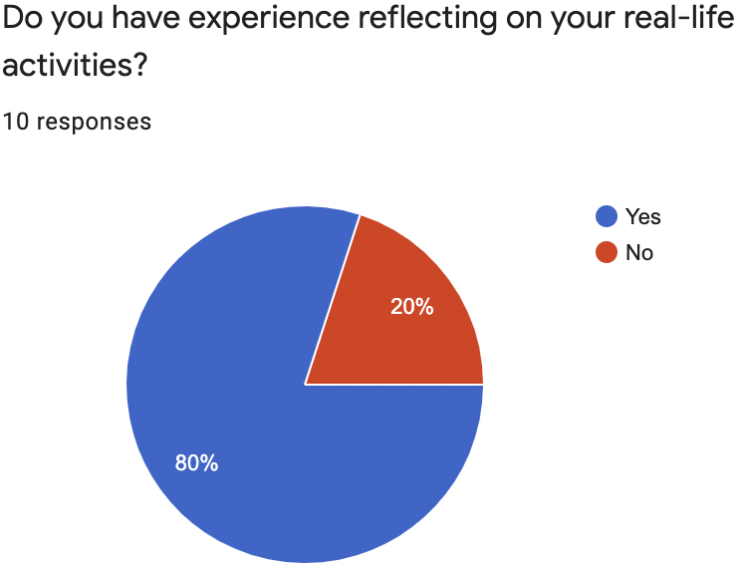
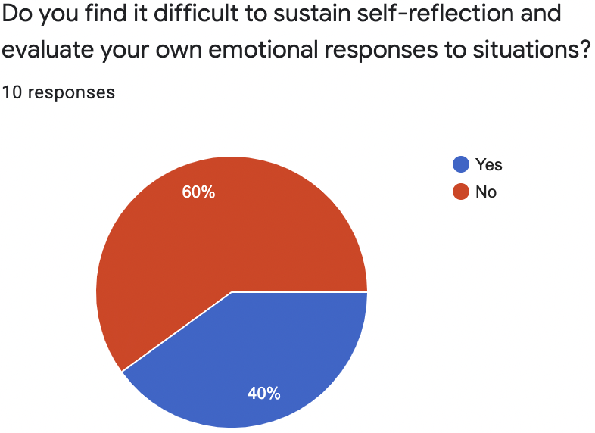
Research Survey
Notes:
Before creating the app, a research survey and exploratory study was carried out.
The research study aimed to discover student’s knowledge on graduate attributes and reflection to discover the level of assistance and explanation that will be required in the app.
Participants were asked yes/no questions, and could explain their answers. Some of these responses can be seen on this slide.
Overall, 1 student was found to have any knowledge of graduate attributes, but all had a good understanding of their importance and stated they would be keen to develop these skills
It was also found that some students do not think about their skills or have experience with reflection, finding it difficult to sustain self-reflection and evaluate their own emotions. This indicates a gap within the current education of students with respect to reflective practices, that an app encouraging reflection could fill. Without these skills students will continue to be underprepared to join the workplace.
(48s)

Slide 7
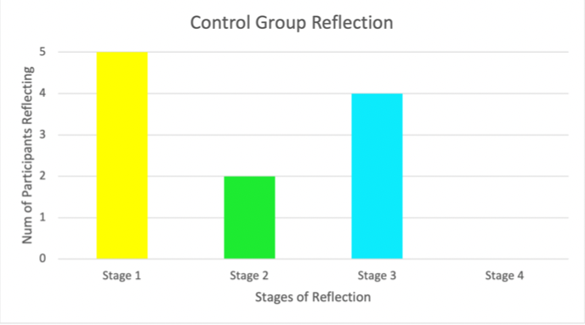
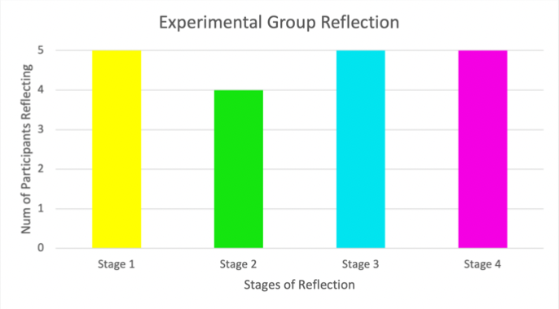
Exploratory Study
Notes:
An exploratory study aimed to answer whether CBT benefits reflection by students on their graduate skills.
It used AB testing in which a control group received job interview style questions, as these intend to promote reflection on real-life experiences, but do not provide any guidance.
The experimental group received the CBT framed questions to support and lead their reflection, potentially encouraging deeper insight and better future situational awareness of their skills.
The stages of reflection stated previously were used, and each participant that carried out a stage of reflection was counted.
The results of this study are shown in this slide in which there is an observable difference. With the CBT styled questions, students were better equipped to have deeper and more insightful reflections. This study was able to demonstrate that CBT does have the ability to be beneficial for student in their graduate attribute reflections.
However, this study was limited and further research would be required to provide conclusive evidence.
(0:56)

Slide 8
Requirements
Functional Requirements
-MH Users must be able to capture a reflection of how and when they have exercised their graduate skills in either written OR audio form.
-SH When creating a written note, there should be help buttons that explain how the user should answer each questions, providing an example, this will give them clear instructions to allow effective reflection.
-CH The app could implement CBT to aid reflection and provide users with a suitable framework to support their reflection.
-WH Users will not be able to upload reflections onto Moodle as this does not provide value for users and could potentially cause privacy issues, as users may not want to upload personal experiences on a public space.
Non-functional Requirements
-MH Must be intuitive and easy to use. An app that is easier for new users is more likely to encourage interest in it.
-SH Users should be able to create quick reflections.
Notes:
The mobile app requirements were split into functional, describing actions users should be able to take with the application,
and nonfunctional requirements, describing criteria that the application needs to meet.
These requirements followed the MoSCoW framework, including must have, should have, could have and won't have.
One example of each type of MoSCoW requirement can be seen here from both functional and non-functional requirements. The non-functional requirements did not include any Could haves or Won't haves.
(30 secs)

Slide 9
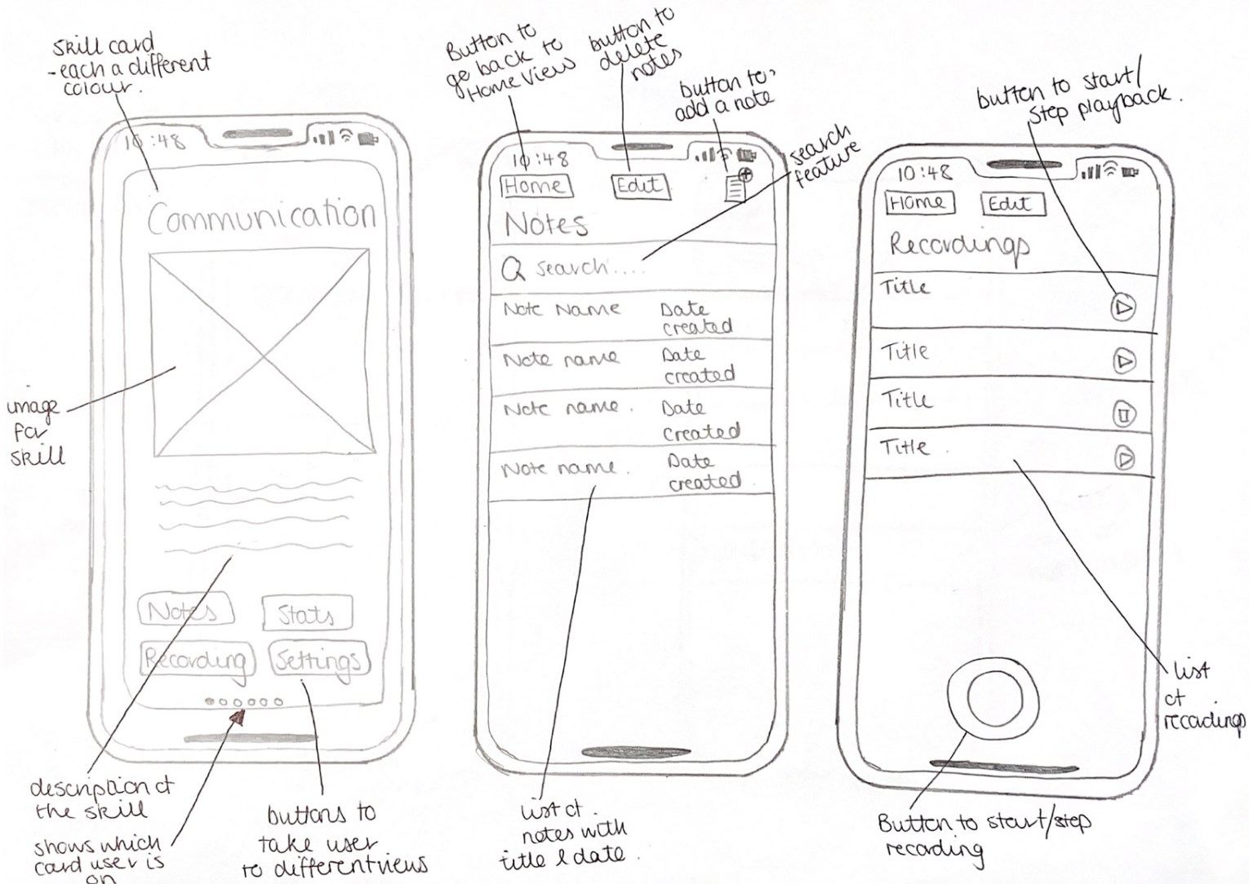
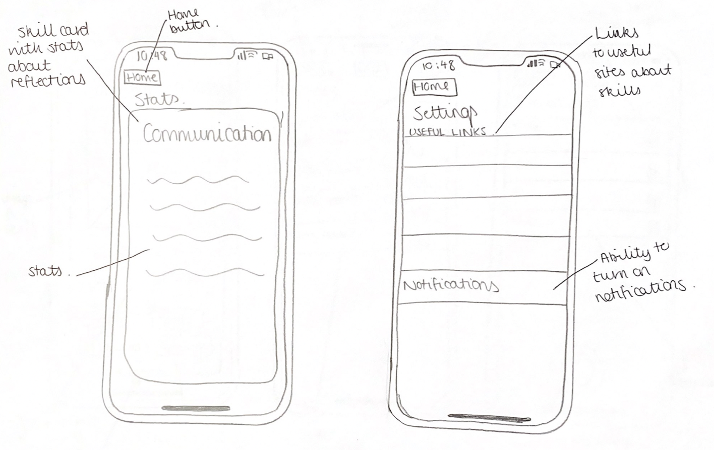
Design
Designed to encourage reflection through:
Written notes
Recorded notes
Statistics
Additional assistance features
Notes:
The app was designed for mobile iOS due to familiarity with the interface design concepts and attractive look of iOS apps.
It was designed to encourage reflection through written notes by using CBT techniques and help buttons.
Recorded notes were designed to provide a different method of reflection that would be quicker and more convenient for a user.
Statistics would provide insight into their reflections and what skills have been developed and what skills require further reflection and development.
These features were designed for the application using prototyping. Paper prototypes were initially used and can be seen on this slide, making sure to maintain external consistency with other note taking applications. These were then made into high fidelity wireframes, and then developed into the fully implemented app.
(40secs)

Slide 10
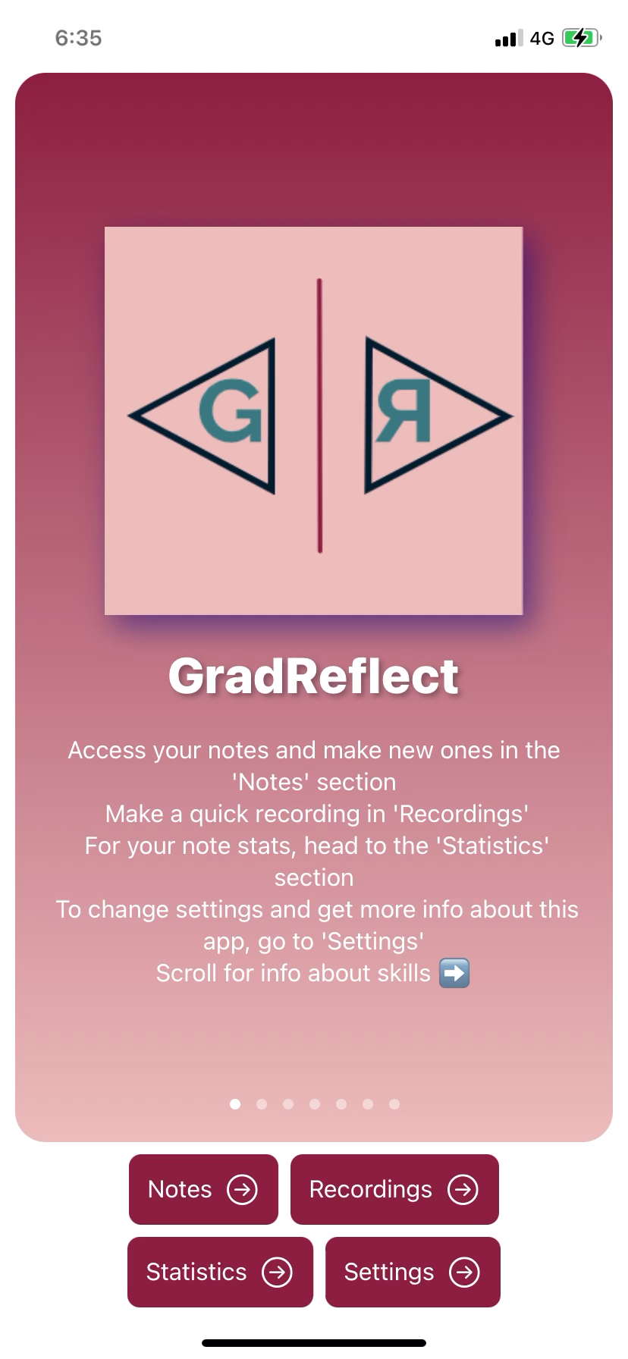
Implementation
Home page
Allows users to learn about skills
Users can navigate to other section of the application from Home.
Settings page
Provides useful links
Can turn on notifications
“About GradReflect” page to describe how to use the app
Notes:
The final application implemented several features to encourage reflection and increase awareness of graduate attributes within students.
Users can learn about graduate skills in the home page by scrolling through each skill as seen in this slide. From here users would be able to navigate to any section of the application.
The settings page provides users with useful links, an about gradreflect page to describe how to use the app and the ability to turn on notification and switch between light and dark theme

Slide 11
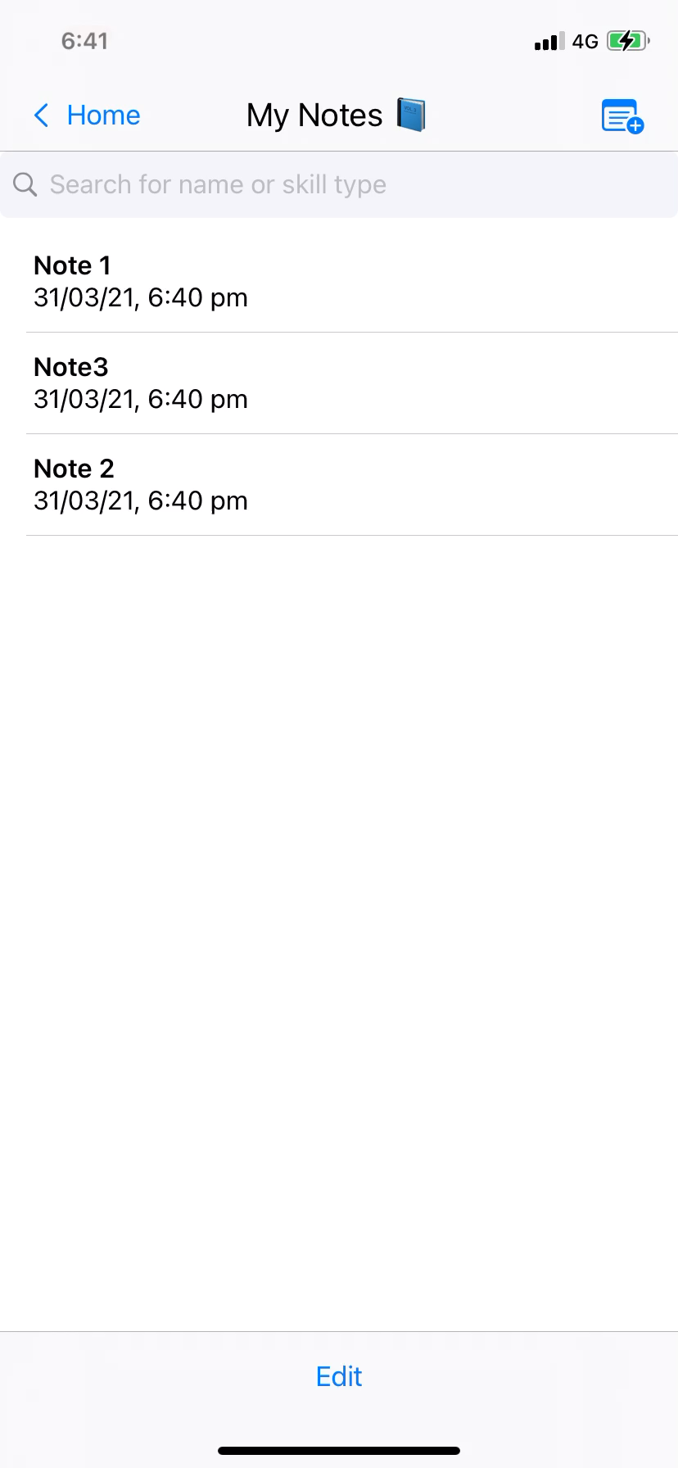
Implementation
Notes page
Can create and delete a note
Help buttons available
Predefined skill list to choose from
Emotions slider
Cannot edit note
Can review notes
Search and filter notes by title and skill
Notes:
Within the notes section of the application users can create and delete a note. The creation of a note uses CBT framed questions to support reflection. The note entry form provides users with a help button for each question, detailing how to answer and reflect for the question with an example. Users can select a skill from the predefined list and choose an emotional response through a sliding scale to make reflection easier.
Users can delete and review a note previously made, but cannot edit it, to replicate the written journaling used in CBT.
Users are able to filter the list of notes created by search for the title or skill type.

Slide 12
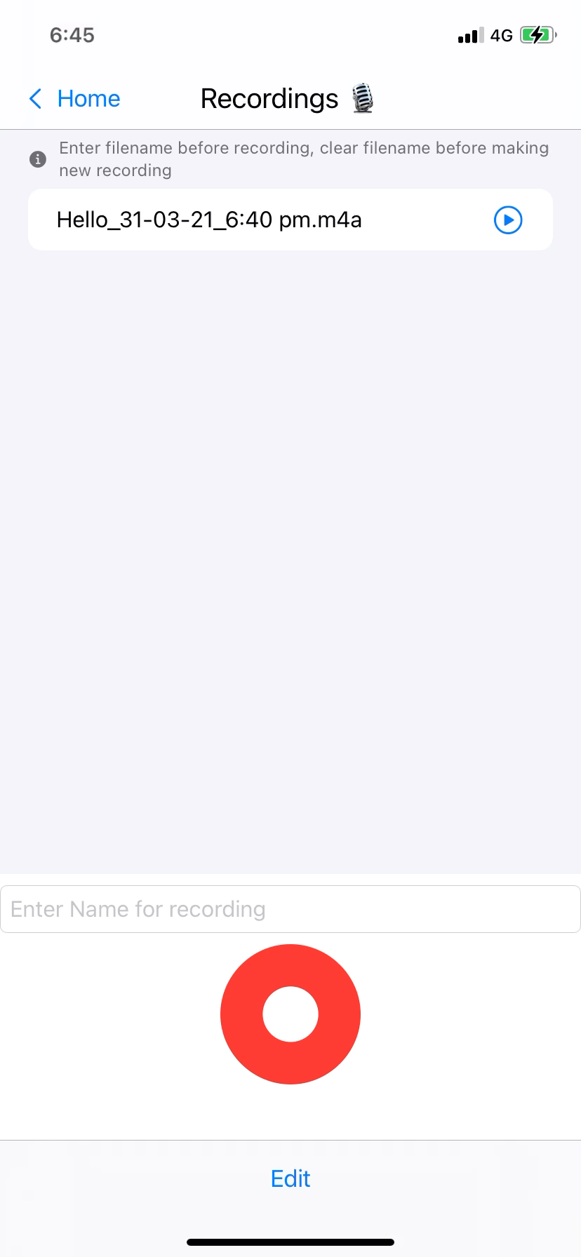
Implementation
Recording page
Record audio with and without a name given
Playback and delete recordings
Statistics Page
View stats based on notes created
Notes:
Within the recordings page users are able to record an audio note with and without a name provided into the name field and play it back. Users can later create fully written notes from these recordings, but the audio format with no framework provided allows users to speak about an experience freely.
Within the statistics page users can view metrics about their written notes including number of notes total, average words per note, average words per note for each skill, average emotional response for each skill and number of notes written for each skill. This is intended to highlight to users where they have and have not developed their skills and how they feel about experiences involving these skills.

Slide 13
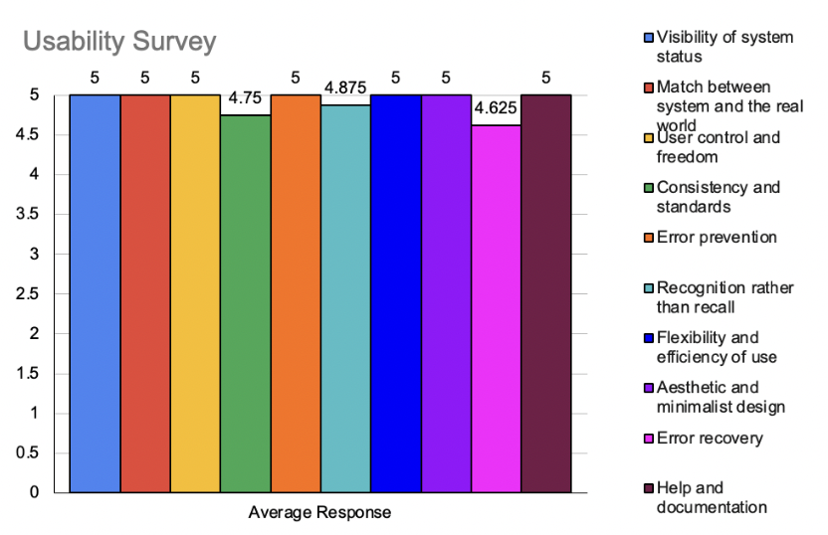
Evaluation
Carried out a monitored evaluation over a remote video conference followed by a two part survey
The first part focussed on the usability
The second part focussed on whether participants found reflection easy, enjoyed certain features and found them useful, as well as if they would continue to use the app.
Notes:
To evaluate the app, participants were given remote control over the application over a Zoom call and asked to complete a set of tasks, exploring each feature of the app.
Following this users were directed to a two part survey. The first section focussed on usability, whilst the second focussed on how users felt about the features in the application and whether they were enjoyable, useful and whether they would want to use them again.
From the monitored evaluation over Zoom it was demonstrated that the aims of the project had been met. Users were able to easily make a note of reflection, use both written and audio form, turn on reminders, and the app appeared easy for them to use and assisted their reflection.
From the first part of the survey, it was clear that users felt the application was highly usable, as can be seen in the average responses in this graph, with only three of Nielsen’s usability heuristics receiving less than a perfect score. In the comments about each of their answers participants stated the app was intuitive and easy to use.
In the seconds section of the survey, all participants stated they enjoy the features of the app with one stating however that stats were not their strong point. The users all stated that they would use the app in the future.
During the evaluation future work was identified both by the evaluator and the participants. Work suggested by participants was being able to view a filtered list of notes by clicking on a specific skill card, and the ability to set goals and receive milestone achievements.

Slide 14
Conclusion
Project involved creating a mobile app to capture graduate attribute reflections
User evaluations were carried out to determine how easy the app was to use and reflect with, and whether the additional features were useful.
Future areas of work involved further CBT research, milestones, note filtering via skill cards and polishing existing implementation.
Notes:
In conclusion this project involved the creation on a mobile app to capture graduate attribute reflections, using Cognitive Behavioural Therapy techniques to provide a supportive framework for students to meaningfully reflect.
User evaluations found the program easy to use, and met the requirements set out early in design.
Future work includes adding the ability to filter the notes via the skill cards, adding goals and milestone achievements as well as other smaller usability changes.
Further research is also required to provide conclusive evidence that CBT is beneficial to students when reflecting on their graduate attributes.
Thank you for listening.

